Slide 1

Exploration of Procedural Terrain Generation on the GPU

Slide 2
Aim and Objectives
Aim: To investigate procedural terrain generation techniques, and how the GPU can be used to generate large-scale terrain more efficiently.
Objectives:
Analyse the algorithms and techniques used for procedural terrain generation.
Implement CPU-based procedural terrain generation using two different noise techniques.
Implement GPU-based procedural terrain generation using two different noise techniques.
Evaluate and compare the performance of each implementation as scale and complexity increases.

Slide 3
Background Research
Focused on noise functions and how they are used for terrain generation
Looked at value noise, diamond-square, Perlin, and Simplex noise
Detailed understanding of how they work so that I could implement them

Slide 4
Implementation
Used knowledge from background review to implement Perlin and Simplex noise
Implemented CPU-based approaches in C++, with code utilising them to procedurally generate terrain
Then implemented them in compute shaders
Outputs written to a texture and reading on CPU side to generate terrain mesh

Slide 5
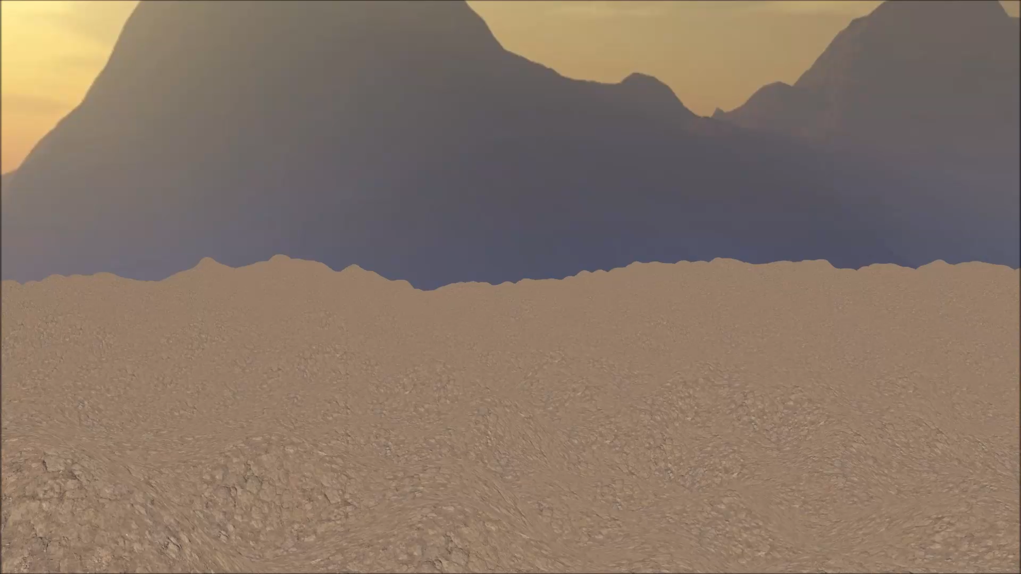

Slide 6
Testing
Measured execution time of each implementation with different parameter values
Testing focused on terrain size and number of octaves
Evaluated performance benefits of using the GPU for parallel computation
Results show an 80%+ reduction for complex terrain (8 octaves) at all sizes

Slide 8
Further Work
Further optimise compute shader code and usage
Implement chunk system to generate parts of terrain
Could then be used to generate terrain in real-time during gameplay

